Slide 1
EN.525.774 – RF & Microwave Circuit I
Final Project
Hoang Nguyen
12/09/2024

Slide 2
Project Requirements
Coupled Bandpass Filter
  Center frequency: 5.8 GHz
  Bandwidth: 580 MHz
  Return loss: minimum of 10 dB
  Use Chebyshev 0.5 dB prototype coefficients (N= 3)
  System impedance of 50 Ohm
5-section open stub Lowpass Filter
  Cutoff frequency: 5.8 GHz
  Return loss: minimum of 15 dB
  Use Chebyshev 0.5 dB prototype coefficient (N=5)
  System Impedance: 50 ohm

Slide 3
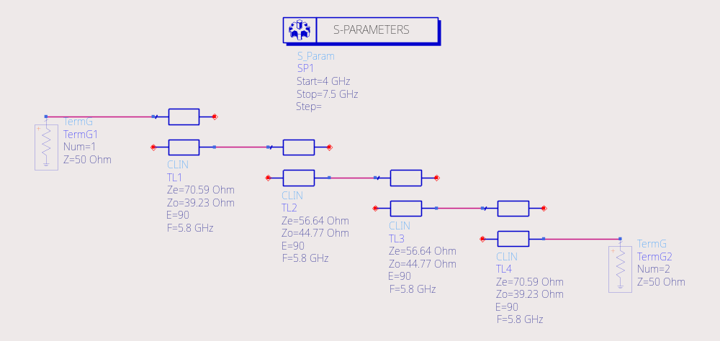
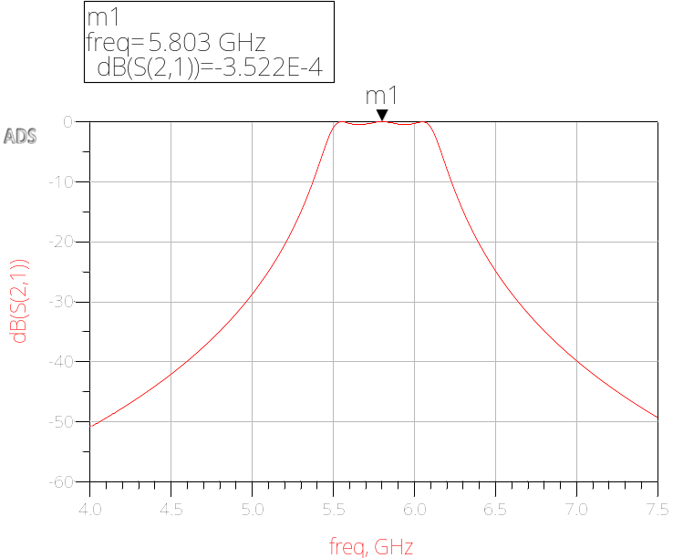
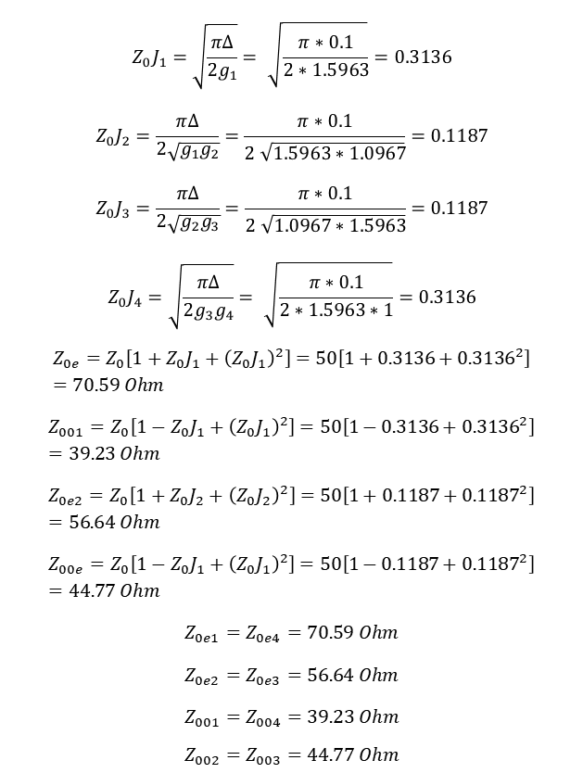
Coupled Bandpass Filter Design and Simulation
$$Z_{0}J_{1}=\sqrt{\frac{π∆}{2g_{1}}}=\sqrt{\frac{π∗0.1}{2∗1.5963}}=0.3136$$
$$Z_{0}J_{2}=\frac{π∆}{2\sqrt{g_{1}g_{2}}}=\frac{π∗0.1}{2\sqrt{1.5963∗1.0967}}=0.1187$$
$$Z_{0}J_{3}=\frac{π∆}{2\sqrt{g_{2}g_{3}}}=\frac{π∗0.1}{2\sqrt{1.0967∗1.5963}}=0.1187$$
$$Z_{0}J_{4}=\sqrt{\frac{π∆}{2g_{3}g_{4}}}=\sqrt{\frac{π∗0.1}{2∗1.5963∗1}}=0.3136$$
$$Z_{0e}=Z_{0}\left[1+Z_{0}J_{1}+{\left(Z_{0}J_{1}\right)}^{2}\right]=50\left[1+0.3136+{0.3136}^{2}\right]=70.59 Ohm$$
$$Z_{001}=Z_{0}\left[1−Z_{0}J_{1}+{\left(Z_{0}J_{1}\right)}^{2}\right]=50\left[1−0.3136+{0.3136}^{2}\right]=39.23 Ohm$$
$$Z_{0e2}=Z_{0}\left[1+Z_{0}J_{2}+{\left(Z_{0}J_{2}\right)}^{2}\right]=50\left[1+0.1187+{0.1187}^{2}\right]=56.64 Ohm$$
$$Z_{00e}=Z_{0}\left[1−Z_{0}J_{1}+{\left(Z_{0}J_{1}\right)}^{2}\right]=50\left[1−0.1187+{0.1187}^{2}\right]=44.77 Ohm$$
$$Z_{0e1}=Z_{0e4}=70.59 Ohm$$
$$Z_{0e2}=Z_{0e3}=56.64 Ohm$$
$$Z_{001}=Z_{004}=39.23 Ohm$$
$$Z_{002}=Z_{003}=44.77 Ohm$$

Slide 4
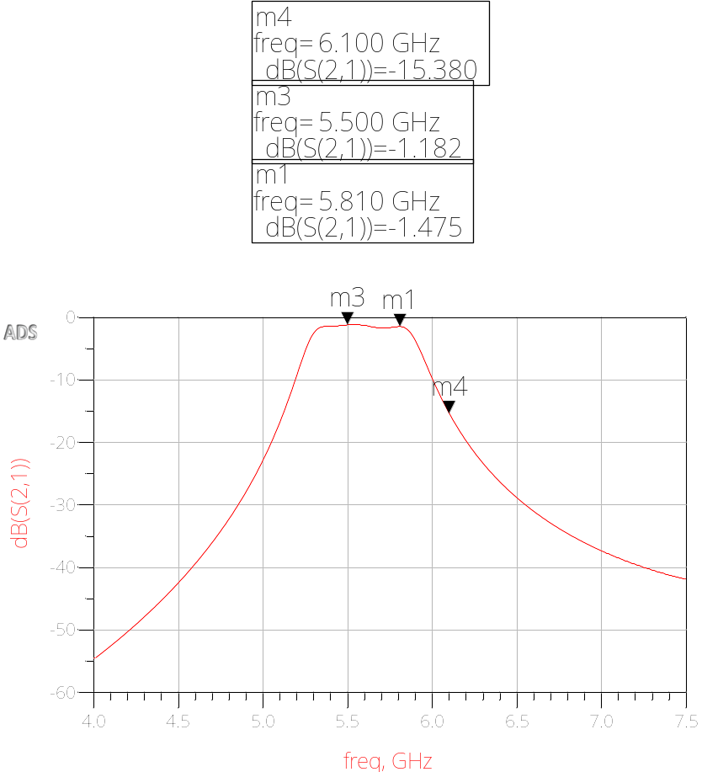
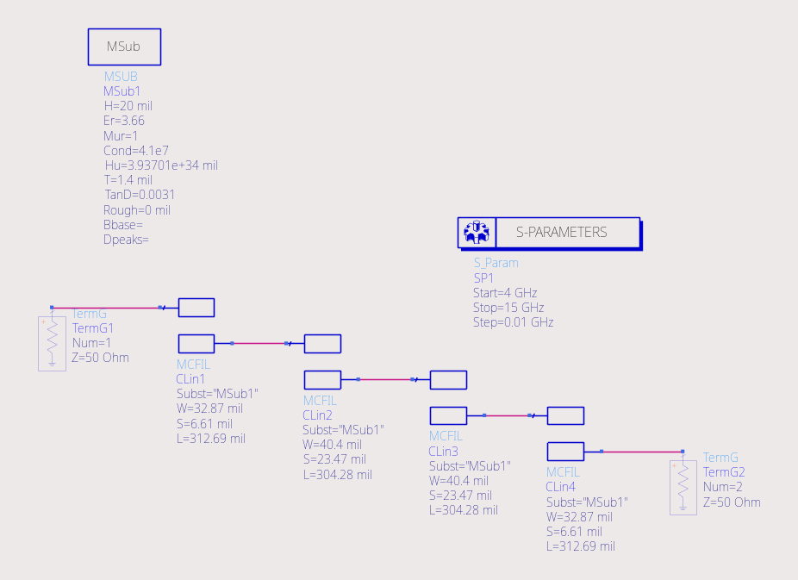
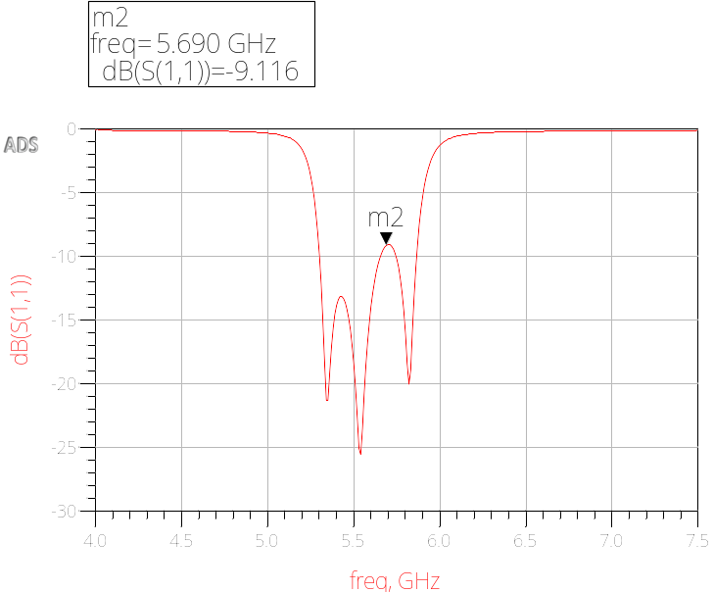
Coupled Bandpass Filter Design and Simulation (Cont.)

Slide 5
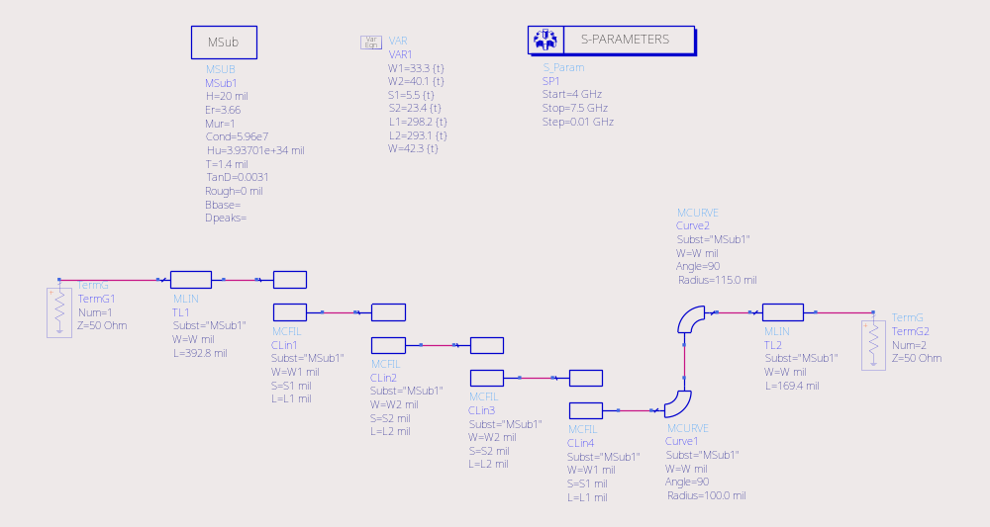
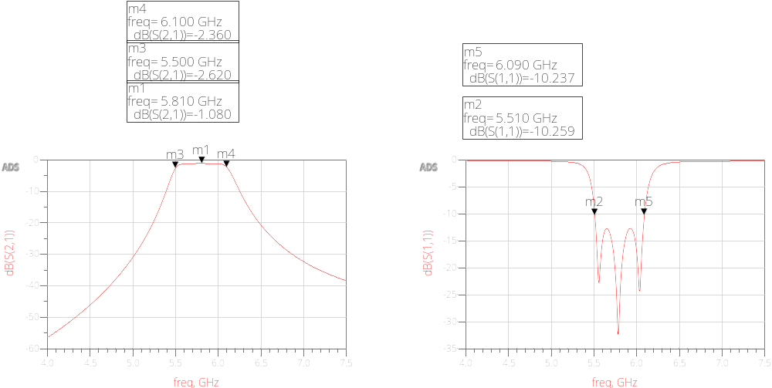
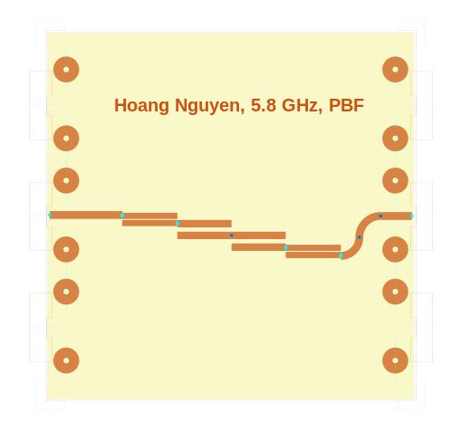
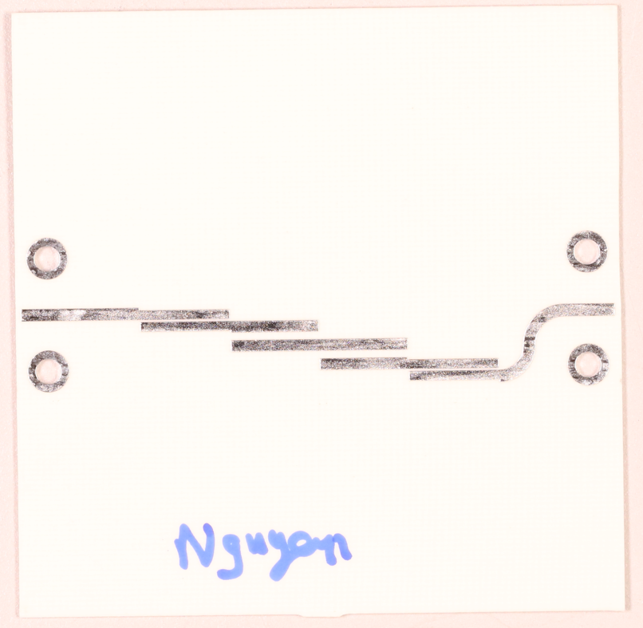
Coupled Bandpass Filter Design and Simulation (Cont.)
 | Before | After
W1 | 32.87 | 33.3
W2 | 40.4 | 40.1
S1 | 6.61 | 5.5
S2 | 23.47 | 23.4
L1 | 312.69 | 298.2
L2 | 304.28 | 293.1

Slide 6
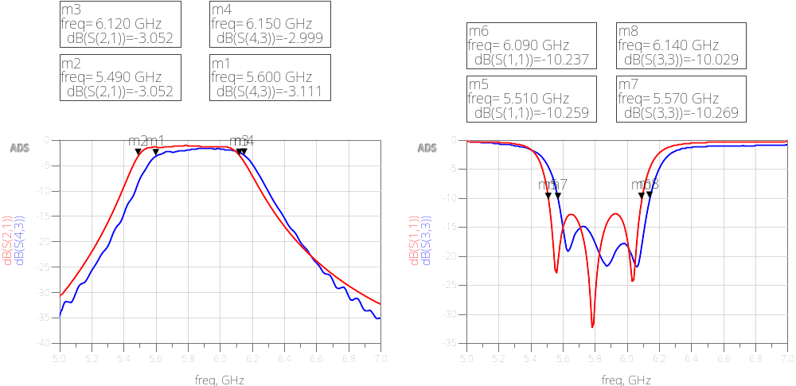
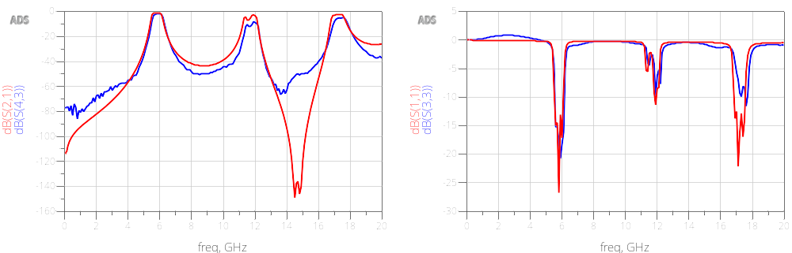
Coupled Bandpass Filter Design and Measurement

Slide 7
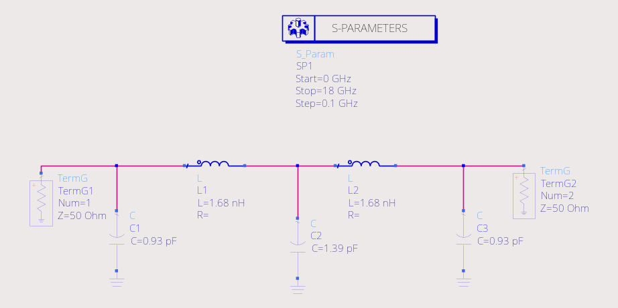
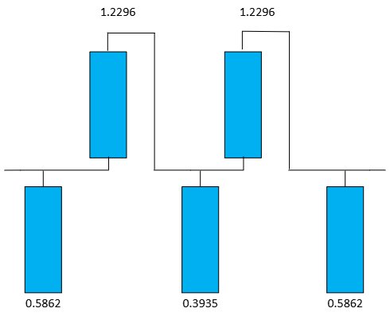
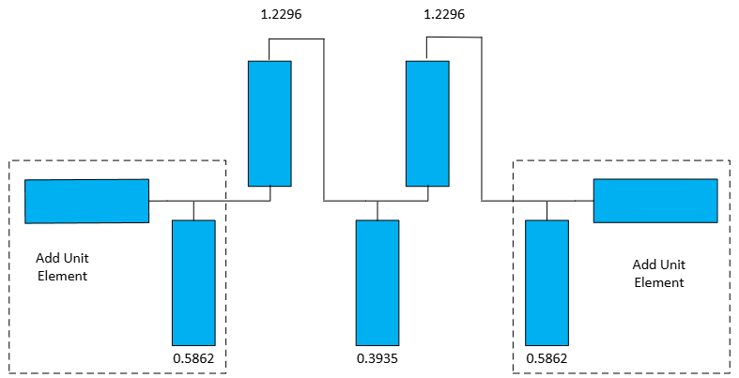
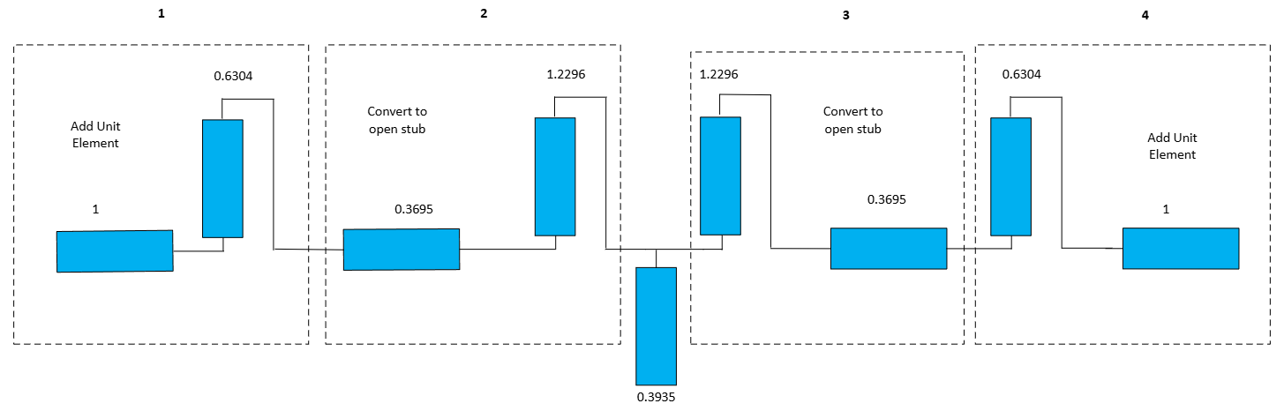
5-Section Open Stub Lowpass Filter Design & Simulation

Slide 8
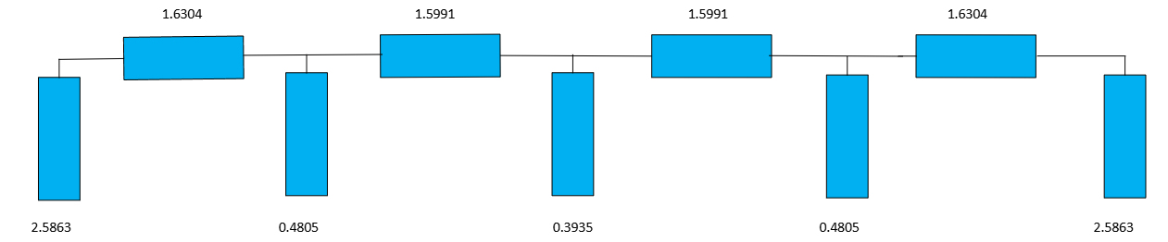
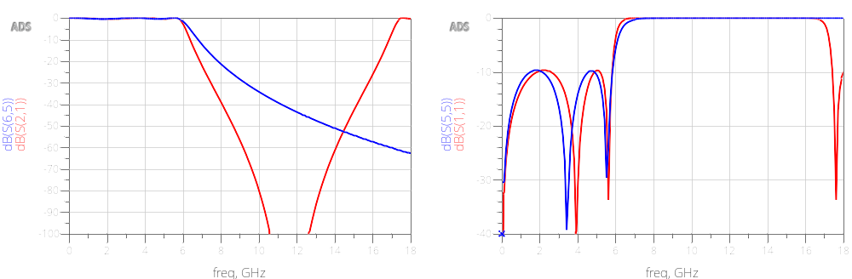
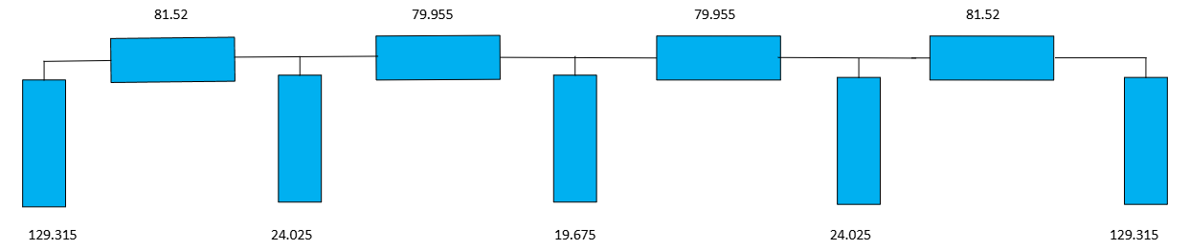
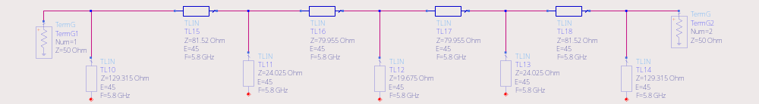
5-Section Open Stub Lowpass Filter Design & Simulation (Cont.)

Slide 9
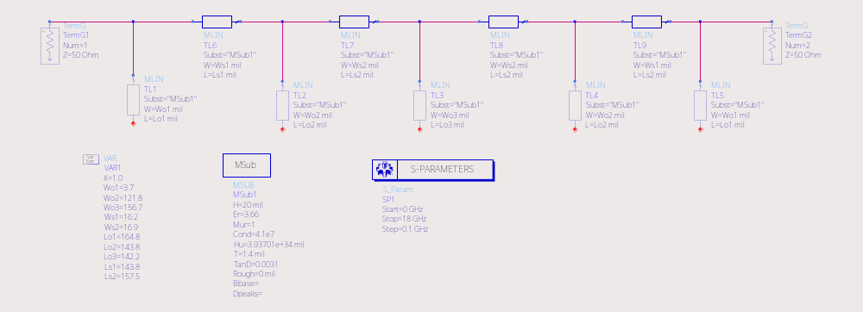
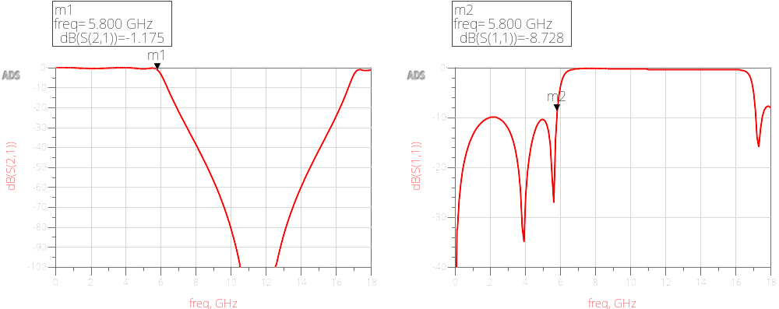
5-Section Open Stub Lowpass Filter Design & Simulation (Cont.)

Slide 10
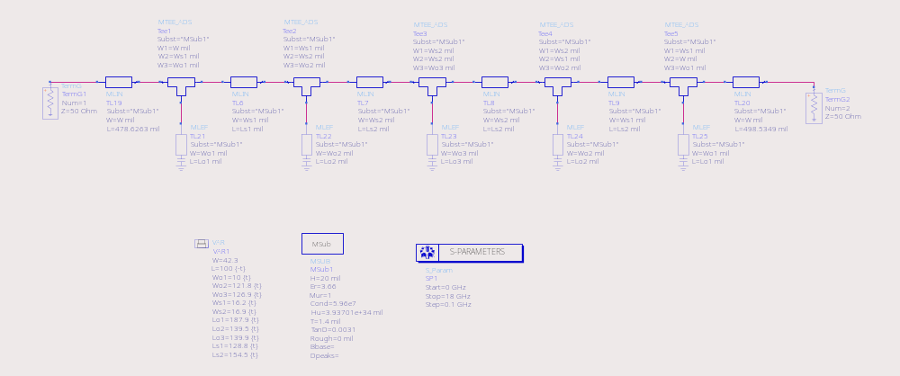
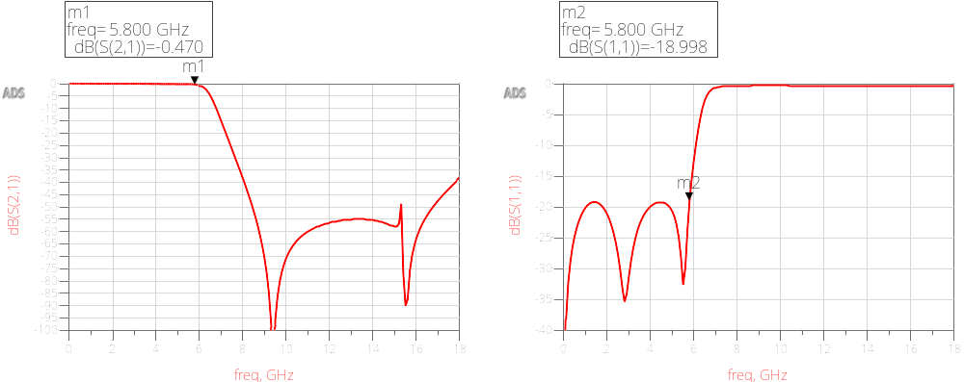
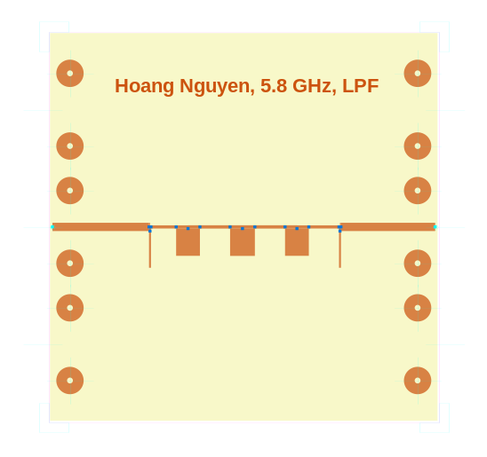
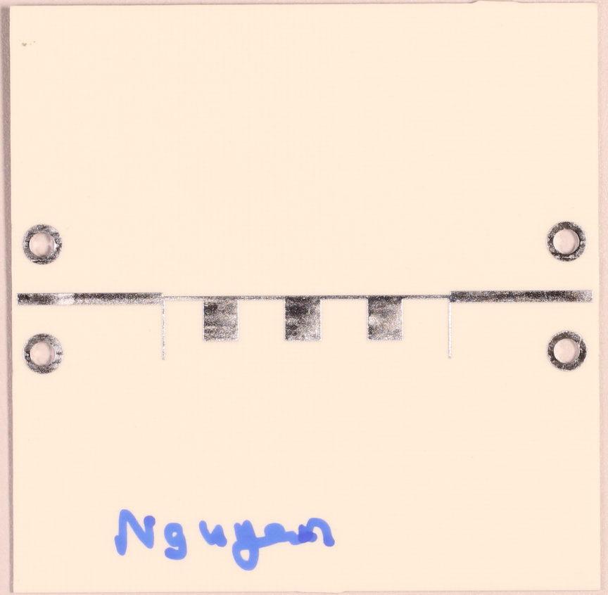
5-Section Open Stub Lowpass Filter Design & Simulation (Cont.)
 | Before | After
Wo1 | 3.7 | 10
Wo2 | 121.8 | 121.8
Wo3 | 156.7 | 126.9
Ws1 | 16.2 | 16.2
Ws2 | 16.9 | 16.9
Lo1 | 164.8 | 187.9
Lo2 | 143.8 | 139.5
Lo3 | 142.2 | 139.9
Ls1 | 143.8 | 128.8
Ls2 | 157.5 | 154.5

Slide 11
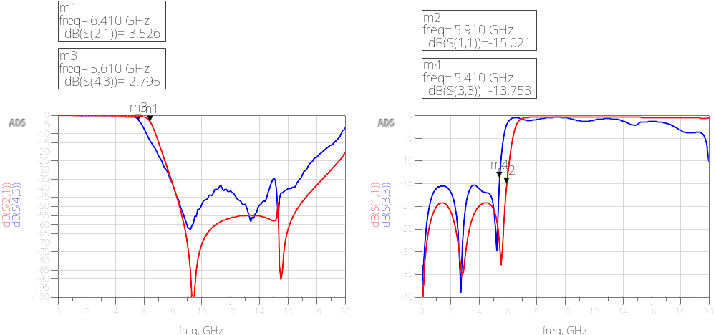
5-Section Open Stub Lowpass Filter Design & Measurement

Slide 12
Conclusion
Coupled Bandpass Filter
Discrepancy between simulation and measurement might be due to:
- Board material tolerance
- Impedance mismatch at 50-ohm input and output with test equipment
- Manufacturing error
 | Center Frequency | Bandwidth | Return loss < 10dB range
Requirement | 5.8 GHz | 580 MHz | 5.510 – 6.090
Simulation | 5.8 GHz | 630 MHz | 5.5 – 6.09
Measurement | 5.87 GHz | 550 MHz | 5.6 – 6.14
5-Section Open Stub Lowpass Filter
 | Cutoff Frequency | Return loss < 15dB range
Requirement | 5.8 GHz | 0 – 5.8 GHz
Simulation | 6.3 GHz | 0 – 5.9 GHz
Measurement | 5.65 GHz | 0-5.4 GHz

